Slide 1
Traditional Symmetric Key Ciphers

Slide 2


Symmetric Keys
cipher text
plain text
Encryption
Decryption
plain text

Slide 3
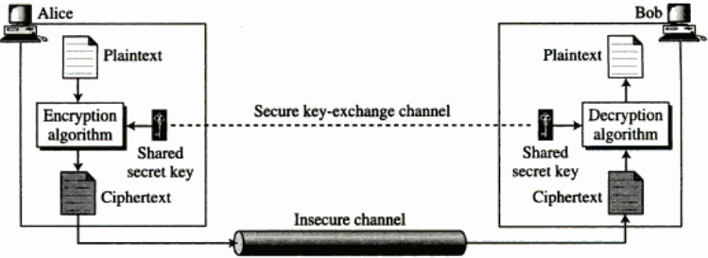

How does it work?

Slide 4


Any flaws?
Key exchange itself is tedious
Multiple Keys for multiple conversations
Bob
key 1
key 2
Charlie
key 3
Daniel
Alice
key 4
Emma

Slide 5
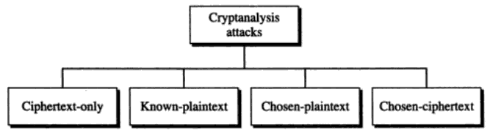
Traditional Symmetric Key Ciphers
cryptanalysis

Slide 6
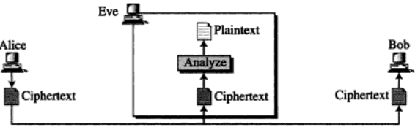
Ciphertext-Only

Slide 7
Brute force Attack
Statistical Attack
Pattern Attack
hello
GHPPK

Slide 8
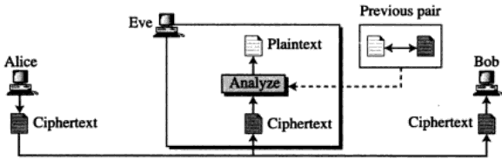
Known Plaintext

Slide 9
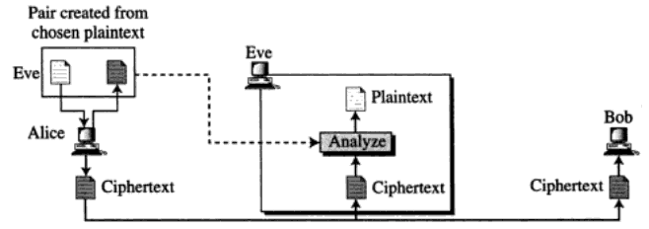
Chosen Plaintext Attack

Slide 10
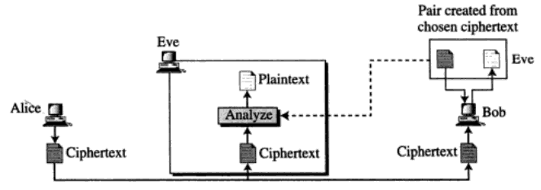
Chosen Ciphertext

Slide 11

Substitution Ciphers
Mono alphabetic Ciphers
Additive or Shift Ciphers
Multiplicative Ciphers

Slide 12
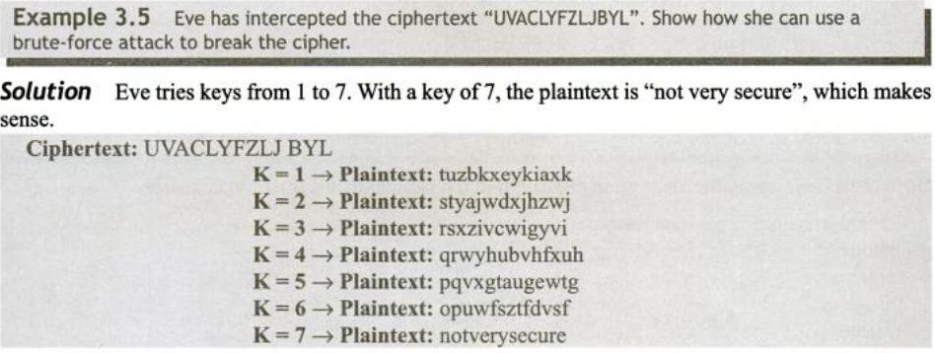
Cryptanalysis on Traditional Ciphers

Slide 13
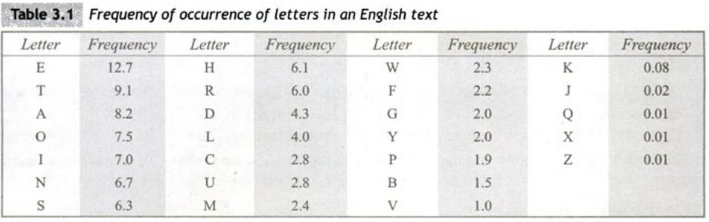
Cryptanalysis on Long Ciphertexts

Slide 14
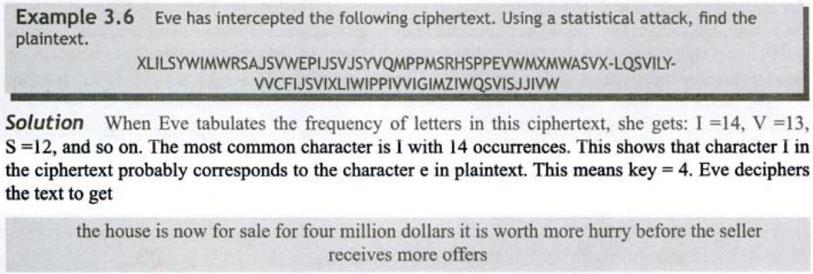
Attacks based on frequency of letters

Slide 15
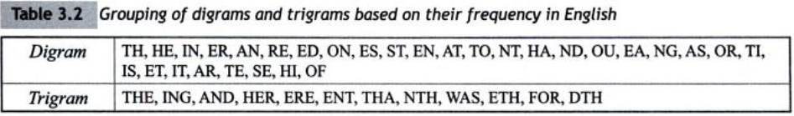
Digrams and Trigrams

Slide 16
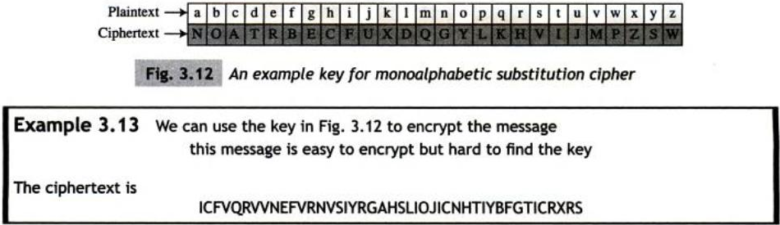
Poly Alphabetic Substitution Ciphers
point to note: The frequency is not changed

Slide 17
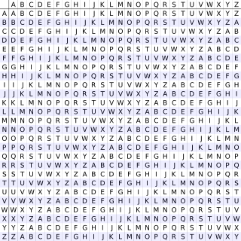
Poly Alphabetic Substitution Cipher

Slide 18
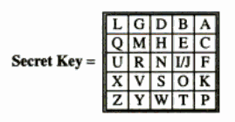
Playfair Cipher
Divide the plain text into digrams.
If there are same letters in a pair, separate them using ‘x’
If there are odd number of letters, add a bogus letter to the end

Slide 19
If two letters of the plaintext are in the same row of the key matrix, shift letters right
If two letters of the plaintext are in the same column of the key matrix, shift letters down
If two letters of the plaintext are diagonal, pick the opposite corners

Slide 20
h e l l o
he ll o
he lx lo
EC QZ BX

Slide 21
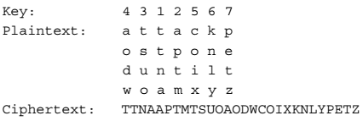
Transposition Techniques
rail fence technique

Slide 22
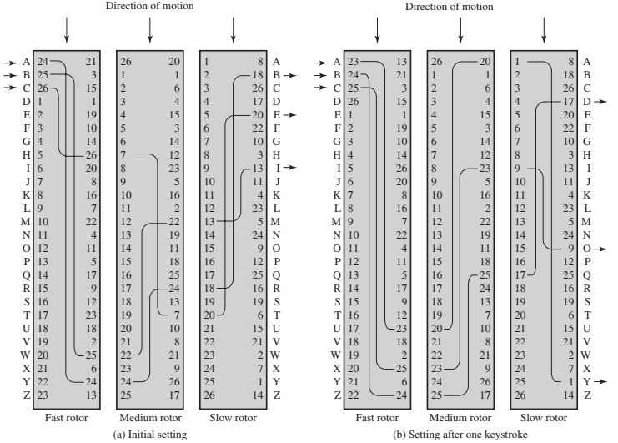
Rotor Machines

